Slide 1

List of Tables
Tap to start presentation

Slide 2
⁕⁕Characteristics of big data⁕⁕
The List of Tables section provides a systematic and well-structured overview of all the tables
included throughout the project. These tables play a vital role in organizing and presenting technical
content related to cloud computing in a simplified, easy-to-understand format. Each table focuses on
a specific area of the topic, helping readers grasp complex ideas more quickly and clearly. The tables
cover a wide range of subtopics essential to understanding cloud computing — from service models
like IaaS, PaaS, and SaaS to deployment methods such as Public, Private, Hybrid, and Community clouds.

Slide 3
⁕⁕Characteristics of big data⁕⁕
Further, tables compare the features and strengths of leading cloud providers like Amazon Web
Services (AWS), Microsoft Azure, and Google Cloud Platform (GCP), making it easier for readers to
evaluate platforms based on their requirements. Additional tables present the core advantages of
cloud computing, important security measures taken to protect cloud data, real-life use cases in
various industries, and the major challenges faced during cloud adoption.

Slide 4
⁕⁕Characteristics of big data⁕⁕
By compiling all this information in tabular form, the project ensures clarity, enhances readability,
and supports academic and professional understanding. This section serves as a guide to help
navigate the report efficiently, offering quick reference points and reinforcing the key concepts
discussed throughout the content.

Slide 5
⁕⁕Topics ⁕⁕
Cloud Service Models.
Char Cloud Deployment Modelsacteristics of big data.
Comparison of Major Cloud Providersypes of digital data.
Advantages of Cloud ComputingChallenges in big data.
Cloud Security Measures
Cloud Computing Use Cases
Challenges in Cloud Adoption

Slide 6
⁕⁕ Cloud Service Models ⁕⁕
☆ Cloud service models include:
IaaS (Infrastructure as a Service): provides virtual servers, storage, and networks. Users manage OS and apps. Data is a collection of facts, numbers, words, or observations that can be used to represent a concept. Data can be used for analysis, reasoning, or planning.
PaaS (Platform as a Service): offers tools for developers to build and deploy applications without managing infrastructure.
SaaS (Software as a Service): delivers ready-to-use software applications over the internet (e.g., Gmail, Dropbox).
Each model offers different levels of control and responsibility.
Choosing the right model depends on the user’s technical needs and available resources.

Slide 7
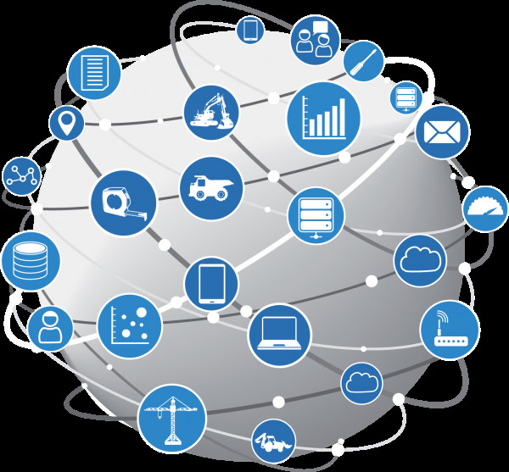
Cloud Deployment Models
☆ Types of cloud deployment models:
Public Cloud: open to everyone; managed by providers like
AWS, Azure.
Private Cloud: used by one organization; offers better control
and security.
Hybrid Cloud: combines public and private models; balances
flexibility and control.
Community Cloud: shared by organizations with similar needs.
Each model suits different requirements based on data sensitivity and scalability.

Slide 8
⁕⁕ Comparison of Major Cloud Providers ⁕⁕
☆ Compares top providers: AWS, Microsoft Azure, Google Cloud (GCP).
AWS: market leader with vast services.
Azure: strong Microsoft integration.
GCP: excellent in AI and analytics.
All offer global infrastructure, flexible pricing, and strong security.
The comparison helps users choose based on use case, budget, and platform preferences.

Slide 9
⁕⁕ Advantages of Cloud Computing ⁕⁕
☆ Major cloud benefits include:
Cost-efficiency: pay only for what you use.
Scalability: easily increase or decrease resources.
Accessibility: work from anywhere with internet.
Reliability: automatic backups and high uptime.
Less Maintenance: handled by the cloud provider.
Ideal for businesses, startups, and institutions.

Slide 10
⁕⁕ Cloud Security Measures ⁕⁕
Key cloud security features:
Data Encryption: secures data during transfer and storage.
Firewalls: prevent unauthorized access.
IAM (Identity & Access Management): controls user permissions.
Compliance: meets legal and industry standards.
Continuous monitoring ensures early detection of threats.

Slide 11
⁕⁕ Cloud Computing Use Cases ⁕⁕
Common applications of cloud computing:
Web Hosting: scalable and reliable site management.
Data Backup & Storage: secure and redundant.
App Development & Testing: fast, scalable environments
Disaster Recovery: restores data quickly after failures.
Big Data & AI: process large-scale information efficiently.
Used across industries like healthcare, education, and finance.

Slide 12
⁕⁕ Challenges in Cloud Adoption ⁕⁕
Key cloud adoption issues:
Data Privacy: risk of exposing sensitive data.
Downtime: service outages can impact operations..
Vendor Lock-in: switching providers may be difficult.
Security Risks: potential for cyberattacks or breaches..
Cost Management: tracking usage can be complex.
Proper planning and governance can reduce these challenges

Slide 13
Thank you
Presented by..
Raj Borad
2214003426

